Slide 1
Statistical problems - drawing conclusions
Numerical representations of data

Slide 2
how to use Oak lessons

Slide 3
I can effectively summarise and communicate conclusions to a statistical problem.

Slide 4
In a data investigation, the population is the entire set of people, creatures, plants or items that make up the whole group which is being studied.
A sample is a subset of the population.
Bias is an error that is caused by including a factor which distorts a dataset in some way.
A statistical summary is a value, or group of values, that help describe a property of a dataset.

Slide 5

Statistical problems - drawing conclusions
Drawing conclusions from a statistical investigation
Acknowledging limitations and problems with conclusions

Slide 6

Drawing conclusions from a statistical investigation
Review of the data cycle:
Statistical investigations start with a question or a problem to solve.
Planning the statistical enquiry and asking a question
Outcomes and actions
Collection of data
data cycle
Organisation and presentation of data
Interpretation of the data
Analysis of the data

Slide 7
Drawing conclusions from a statistical investigation
We then collect some data that addresses the problem, while being careful not to do anything that might cause the data to be biased.
Planning the statistical enquiry and asking a question
Outcomes and actions
Collection of data
data cycle
Organisation and presentation of data
Interpretation of the data
Analysis of the data

Slide 8
Drawing conclusions from a statistical investigation
The data then needs to be organised and presented in a format that makes it easy to analyse and interpret (e.g. in a table or graph).
Planning the statistical enquiry and asking a question
Outcomes and actions
Collection of data
data cycle
Organisation and presentation of data
Interpretation of the data
Analysis of the data

Slide 9
Drawing conclusions from a statistical investigation
We then analyse the data using methods which are appropriate for addressing the problem (e.g. calculating averages and the range).
Planning the statistical enquiry and asking a question
Outcomes and actions
Collection of data
data cycle
Organisation and presentation of data
Interpretation of the data
Analysis of the data

Slide 10
Drawing conclusions from a statistical investigation
After creating the statistical summaries or graphs that we need, we can draw conclusions and present the data in a way that illustrates the conclusions.
Planning the statistical enquiry and asking a question
Outcomes and actions
Collection of data
data cycle
Organisation and presentation of data
Interpretation of the data
Analysis of the data

Slide 11
Drawing conclusions from a statistical investigation
These conclusions may lead to decisions or actions that address the problem that prompted the investigation.
Planning the statistical enquiry and asking a question
Outcomes and actions
Collection of data
data cycle
Organisation and presentation of data
Interpretation of the data
Analysis of the data

Slide 12
Drawing conclusions from a statistical investigation
This lesson focuses on the final two steps in the data cycle.
Planning the statistical enquiry and asking a question
Outcomes and actions
Collection of data
data cycle
Organisation and presentation of data
Interpretation of the data
Analysis of the data

Slide 13
Drawing conclusions from a statistical investigation
Statistical summaries can be a useful way to make sense of large amounts of data. This can be helpful for drawing conclusions and deciding what actions may be needed.
Graphical representations of data can also be useful tools for drawing conclusions.
They can help you investigate findings in more depth by allowing you to make comparisons between different aspects of the dataset.

Slide 14
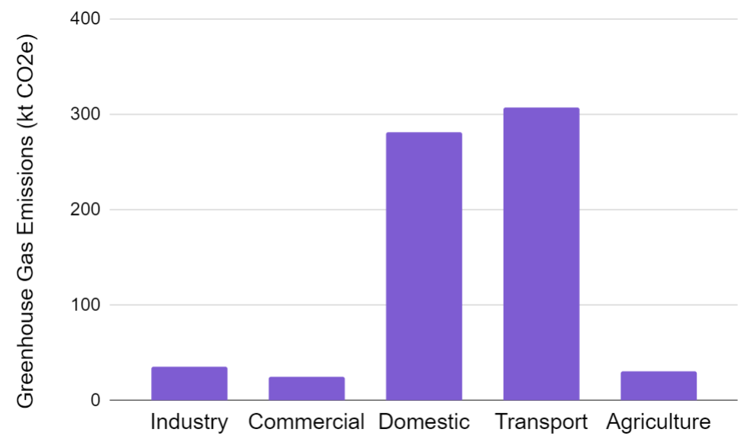
Drawing conclusions from a statistical investigation
A town council is investigating ways to manage the levels of greenhouse gas emissions in their town.
They collect data about the volume of emissions from different sectors of the town.
What conclusions could be drawn from this bar chart?
Transport causes the most emissions.
Domestic causes the second most amount of emissions.

Slide 15
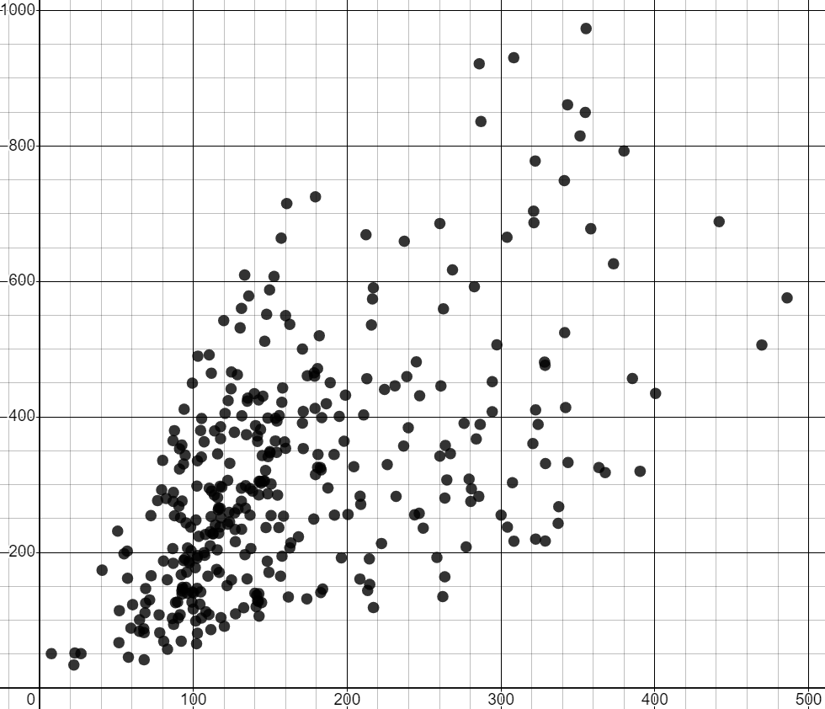
Drawing conclusions from a statistical investigation
The council choose to examine the emissions from transport further.
The scatter graph shows data from the ONS about population sizes and transport emissions for regions around the UK in 2019.
What correlation does it show?
What does that tell us about the relationship between population and transport greenhouse gas emissions?
positive correlation
transport greenhouse gas emissions (kt CO2e)
The greater the population, the more transport greenhouse gas emissions.
population (thousands)

Slide 16
Drawing conclusions from a statistical investigation
This town has a population of 101 thousand people.
Their greenhouse gas emissions from transport were 307 kt CO2e.
What transport emissions what you would expect for a town with this population?
800
600
transport greenhouse gas emissions (kt CO2e)
between 50 and 450 kt CO2e
400
200
Is this town’s transport emissions unusually high for its population?
0
0
100
200
300
400
no
population (thousands)

Slide 17
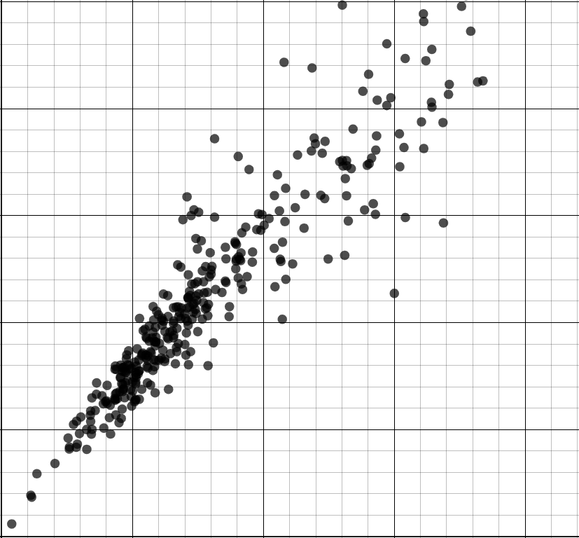
Drawing conclusions from a statistical investigation
They then use ONS data to examine domestic greenhouse gas emissions. This town’s domestic emissions were 281 kt CO2e.
What domestic emissions would you expect for a town with a population of 101 thousand?
400
300
domestic greenhouse gas emissions (kt CO2e)
between 120 and 180 kt CO2e
200
100
Is this town’s domestic emissions unusually high for its population?
0
0
100
200
300
400
yes
population (thousands)

Slide 18
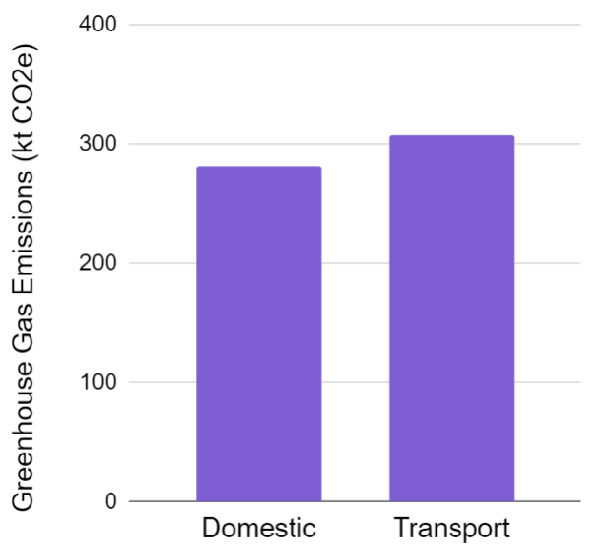
Drawing conclusions from a statistical investigation
Summary:
Transport emissions were the town’s greatest cause of greenhouse gases.
However, the amount was not unusual for a town of their population size.
Domestic emissions were the second greatest cause of greenhouse gases.
This amount was unusually high for a town of their population size.
transport emissions
domestic emissions
population
population

Slide 19
Drawing conclusions from a statistical investigation
What actions might the council take following this investigation?
Try to maintain or reduce transport emissions because they are the greatest cause of greenhouse gases.
Focus particularly on reducing domestic greenhouse gas emissions because they are unusually high for a town of this size.
transport emissions
domestic emissions
population
population

Slide 20
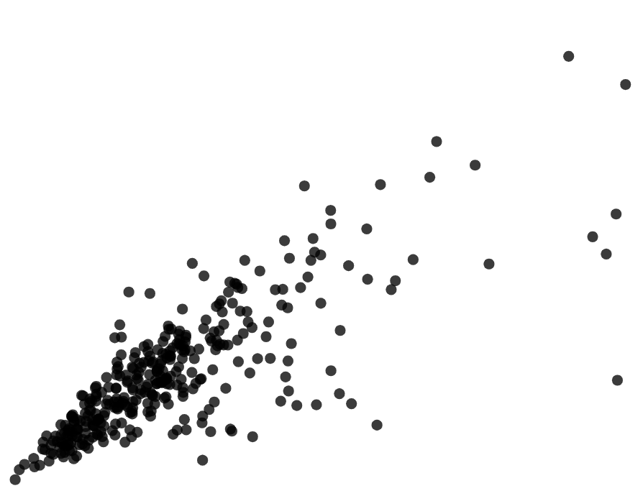

Drawing conclusions from a statistical investigation
In which scatter graph is the point marked with a cross inside the usual range of data?

Slide 21
Drawing conclusions from a statistical investigation
1) A bus company have 98 thousand passengers per day. The table shows the mean number of passengers they have each time of the day.
time | mean number of passengers (thousands)
06:00 - 10:00 | 34.3
10:00 - 14:00 | 19.6
14:00 - 18:00 | 29.4
18:00 - 22:00 | 14.7
a) The bus company wants to encourage more people to travel at unpopular times of the day by offering cheaper tickets. Which time period should tickets be cheaper?
b) The bus company wants to improve profits by increasing ticket prices at the most popular time of the day. For which time period should prices increase?

Slide 22
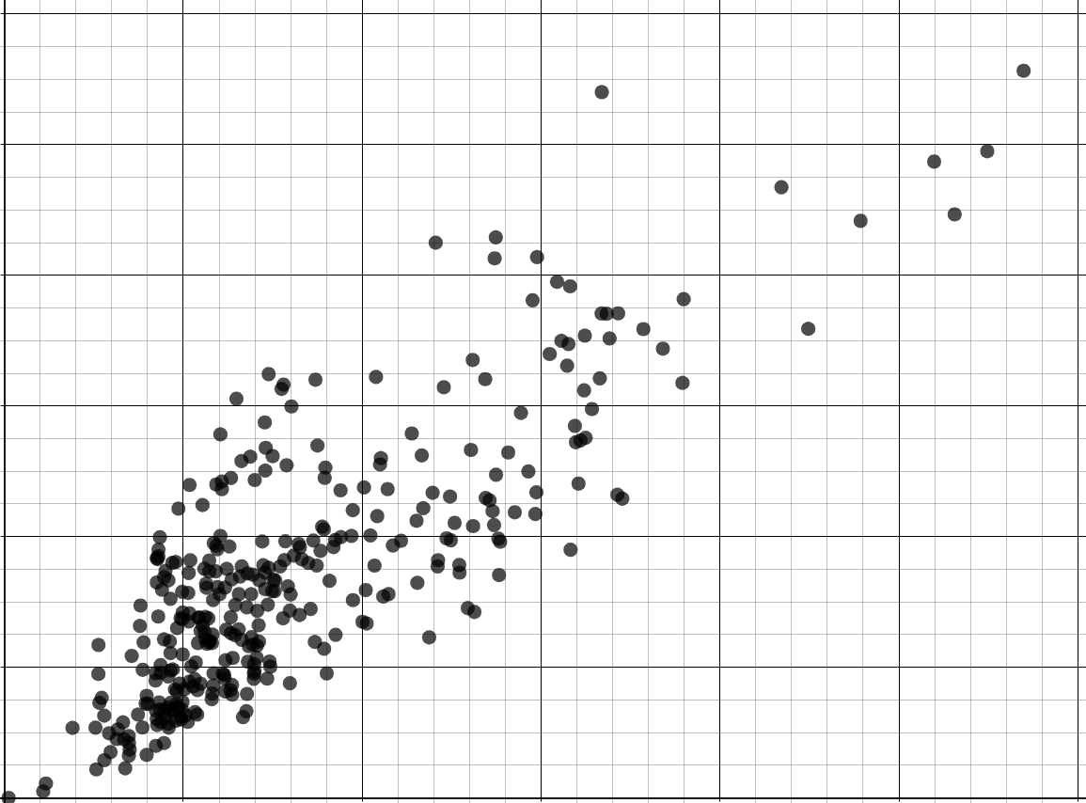
Drawing conclusions from a statistical investigation
2) A mobile phone provider manages the number of cell towers per town. The table shows the population and the number of cell towers for three towns. The scatter graph shows data from the ONS about other regions across the UK.
12
town | A | B | C
population (thousands) | 300 | 400 | 60
cell towers (thousands) | 7 | 4 | 6
10
8
cell towers (thousands)
6
4
a) In which town should they install more cell towers? Explain why.
2
0
b) In which town can they afford to switch off some cell towers? Explain why.
0
100
200
300
400
500
600
population (thousands)

Slide 23
Drawing conclusions from a statistical investigation
1) A bus company have 98 thousand passengers per day. The table shows the mean number of passengers they have each time of the day.
time | mean number of passengers (thousands)
06:00 - 10:00 | 34.3
10:00 - 14:00 | 19.6
14:00 - 18:00 | 29.4
18:00 - 22:00 | 14.7
a) The bus company wants to encourage more people to travel at unpopular times of the day by offering cheaper tickets. Which time period should tickets be cheaper?
18:00 - 22:00
b) The bus company wants to improve profits by increasing ticket prices at the most popular time of the day. For which time period should prices increase?
06:00 - 10:00

Slide 24
Drawing conclusions from a statistical investigation
2) A mobile phone provider manages the number of cell towers per town. The table shows the population and the number of cell towers for three towns. The scatter graph shows data from the ONS about other regions across the UK.
12
town | A | B | C
population (thousands) | 300 | 400 | 60
cell towers (thousands) | 7 | 4 | 6
10
8
cell towers (thousands)
6
4
a) In which town should they install more cell towers? Explain why.
2
Town B
0
4 thousand cell towers is less than most other regions with a similar population.
0
100
200
300
400
500
600
population (thousands)

Slide 25
Drawing conclusions from a statistical investigation
2) A mobile phone provider manages the number of cell towers per town. The table shows the population and the number of cell towers for three towns. The scatter graph shows data from the ONS about other regions across the UK.
12
town | A | B | C
population (thousands) | 300 | 400 | 60
cell towers (thousands) | 7 | 4 | 6
10
8
cell towers (thousands)
6
4
b) In which town can they afford to switch off some cell towers? Explain why.
2
Town C
0
6 thousand cell towers is more than most other regions with a similar population.
0
100
200
300
400
500
600
population (thousands)

Slide 26
Statistical problems - drawing conclusions
Drawing conclusions from a statistical investigation
Acknowledging limitations and problems with conclusions

Slide 27


Acknowledging limitations and problems with conclusions
Lucas surveyed a sample of 10-year-old children about which genres of books they like to read.
Sofia is organising a book collection for an elderly care home.
Lucas’s data shows that fantasy and comedy books were the most popular.
So I will find lots of those for the collection.
comedy horror fantasy sci-fi romance
What could be wrong with Sofia’s conclusion?
Elderly people might not like the same genres of books as children.

Slide 28


Acknowledging limitations and problems with conclusions
When we make conclusions from data investigations, we should consider the limitations to those findings.
Care should be taken not to over generalise the results from a statistical investigation.
I surveyed 20 people and found they they spend an average 1 hour 32 minutes watching TV per day.
This must mean that everyone in the world watches TV for 1 hour 32 minutes every day.
Izzy
Sam
Sam’s conclusion may not be valid because time watching TV may vary according to age, country or other factors.

Slide 29
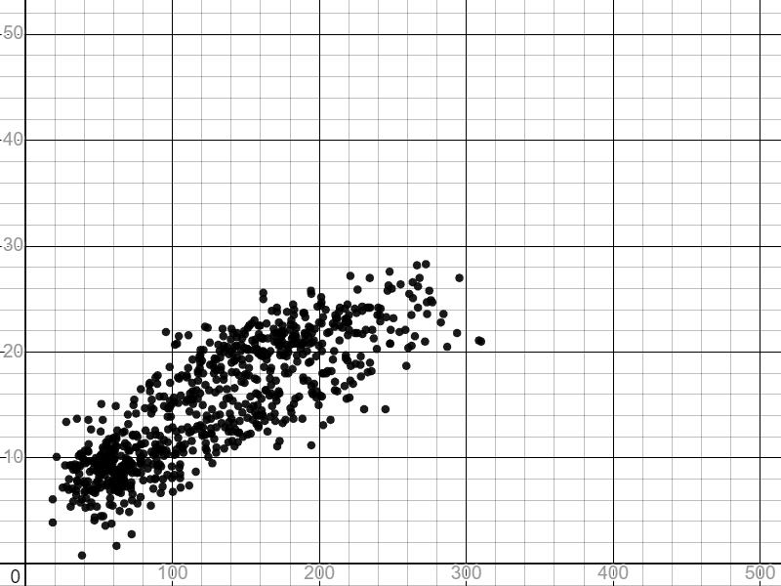

Acknowledging limitations and problems with conclusions
Over generalising can be caused by extrapolating findings beyond the range of a data set.
50
If next June has 450 hours of sunshine, we should expect the maximum temperature to be between 40℃ and 50℃.
40
mean of daily maximum temperature (℃)
30
20
10
Andeep’s conclusion may not be valid because he has extrapolated from beyond the data range.
0
Andeep
0
100
200
300
400
500
total sunshine duration (hours)

Slide 30


Acknowledging limitations and problems with conclusions
We should consider anything that might have biased the investigation before we draw conclusions.
I went to a gym and surveyed a sample of adults about how much time they spend exercising per week. The mean amount of time was 4 hours 28 minutes.
This must mean that every adult exercises for around 4 hours 28 minutes per week.
Jacob
Laura
Laura’s conclusion may not be valid because people at the gym may exercise more than the general population.

Slide 31



Acknowledging limitations and problems with conclusions
Conclusions made about data collected from a sample may only be valid for the sample of data or a population that is fully represented by the sample.
I surveyed 20 people aged 11 years old about how much time they spend doing homework. The mean was 5 hours per week.
People in the school spend around 5 hours a week doing homework.
Alex
11-year-olds in this school spend around 5 hours a week doing homework.
Aisha
Jun
Who has the most valid conclusion? Alex or Jun?
Jun

Slide 32
Acknowledging limitations and problems with conclusions
Conclusions made from an investigation can always be applied to the whole population.
The data provides evidence that the conclusion is correct.
The conclusion is only valid for the sample or a population that is fully represented by the sample.

Slide 33
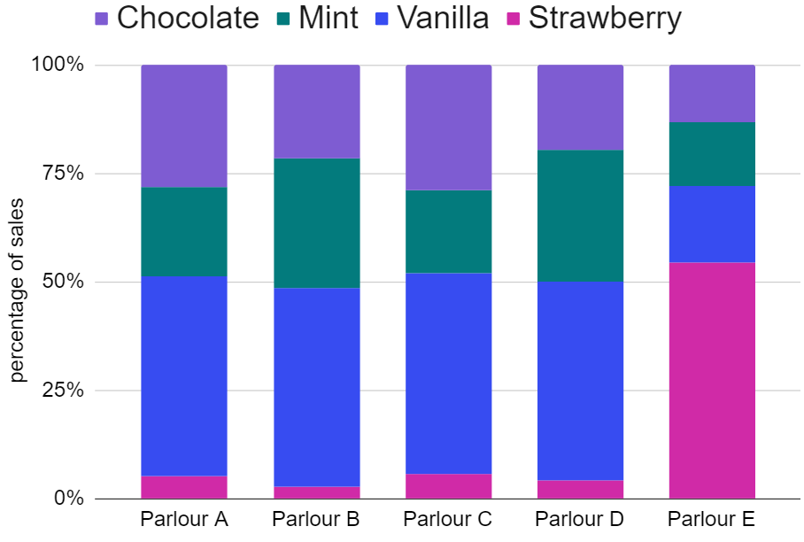
Acknowledging limitations and problems with conclusions
A manager collects data from all five ice cream parlours in a chain.
The stacked bar chart shows the percentage of sales for each flavour at each parlour.
Which flavour tends to be the most popular across the chain?
vanilla
Which flavour tends to be the least popular across the chain?
strawberry

Slide 34
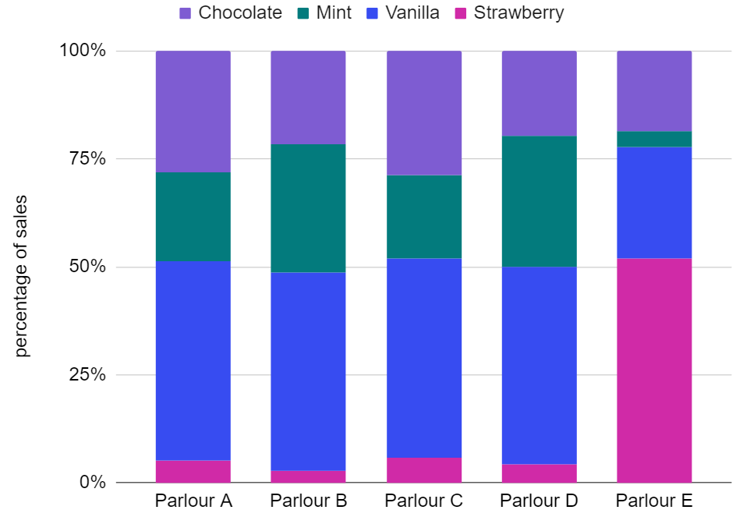
Acknowledging limitations and problems with conclusions
Based on the conclusions of the investigation, the manager decides to replace strawberry with a different flavour across all five parlours.
What problem could there be with this outcome?
Strawberry is the most popular flavour in one of the parlours.
Over half of the sales in that parlour are strawberry flavour.

Slide 35
Acknowledging limitations and problems with conclusions
Based on the conclusions of the investigation, the manager decides to replace strawberry with a different flavour across all five parlours.
What could be an alternative outcome to the investigation?
Replace the strawberry flavour in all the parlours except for one where it is most popular.

Slide 36
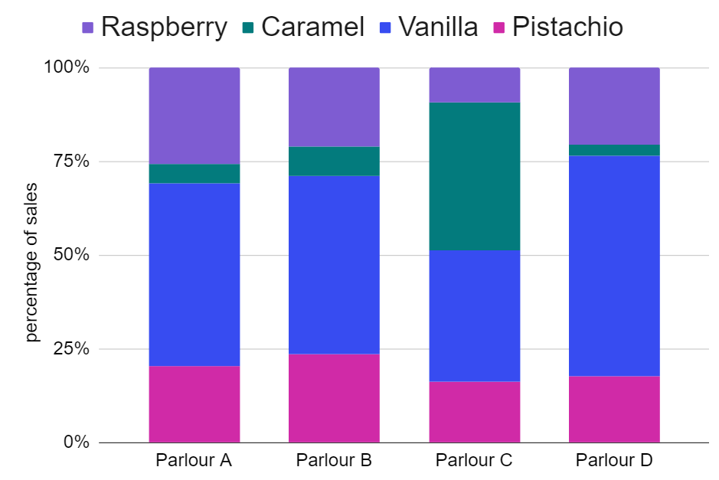
Acknowledging limitations and problems with conclusions
Which parlour would make the biggest loss if they stopped selling caramel flavour (assuming those customers didn’t buy other flavours)?
Parlour A
Parlour B
Parlour C
Parlour D

Slide 37
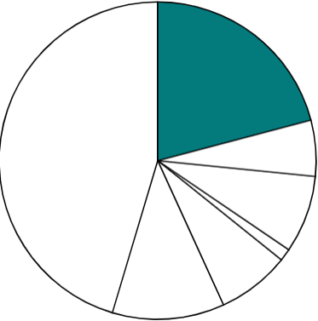
Acknowledging limitations and problems with conclusions
1) The pie chart shows data (by the ONS) from a survey in 2021 about how people travel to work in the City of London.
underground rail
If we use this data from London as a sample then we can conclude that around 21% of people in the UK also travel to work by underground rail.
21%
train
bus
Alex
walk
taxi
car
cycle
Explain why Alex could be wrong.

Slide 38


Acknowledging limitations and problems with conclusions
2) The table shows data from the ONS about the number of property sales each year in Liverpool.
year | properties sold
2018 | 6957
2019 | 6530
2020 | 4524
2021 | 6039
2022 | 5135
mean | 5837
a) Andeep concludes that most cities in the UK must sell around 5837 properties per year. Explain why Andeep could be wrong.
b) Laura concludes that Liverpool will always sell around 5837 properties every year. Explain why Laura could be wrong.

Slide 39
Acknowledging limitations and problems with conclusions
1) The pie chart shows data (by the ONS) from a survey in 2021 about how people travel to work in the City of London.
underground rail
If we use this data from London as a sample then we can conclude that around 21% of people in the UK also travel to work by underground rail.
21%
train
bus
Alex
walk
taxi
car
Explain why Alex could be wrong.
cycle
The sample only uses data from a single location.
Modes of transport may differ depending on whether they live in a town or city.
Not all towns and cities have an underground rail network.

Slide 40
Acknowledging limitations and problems with conclusions
2) The table shows data from the ONS about the number of property sales each year in Liverpool.
year | properties sold
2018 | 6957
2019 | 6530
2020 | 4524
2021 | 6039
2022 | 5135
mean | 5837
a) Andeep concludes that most cities in the UK must sell around 5837 properties per year. Explain why Andeep could be wrong.
Cities vary in size.
Bigger cities may sell more properties each year.
Smaller cities may sell few properties each year.

Slide 41
Acknowledging limitations and problems with conclusions
2) The table shows data from the ONS about the number of property sales each year in Liverpool.
year | properties sold
2018 | 6957
2019 | 6530
2020 | 4524
2021 | 6039
2022 | 5135
mean | 5837
b) Laura concludes that Liverpool will always sell around 5837 properties every year. Explain why Laura could be wrong.
The number of property sales might change in the future (e.g. if the population increases or more houses are built). 2020 had an unusually low number of sales.

Slide 42
Statistical problems - drawing conclusions
Conclusions can be drawn from statistical summaries and graphical representations.
Care should be taken not to over generalise the results from a statistical investigation.
Conclusions are understood to be limited by any biases.
Conclusions may only be valid for this sample of data.
Context may be important for determining the outcome of a statistical investigation.

Slide 43

© Oak National Academy 2023.
Produced in partnership with Mathematics in Education and Industry.
Licensed on the Open Government Licence v3.0, except where otherwise stated. See Oak terms and conditions.

